Slide 1


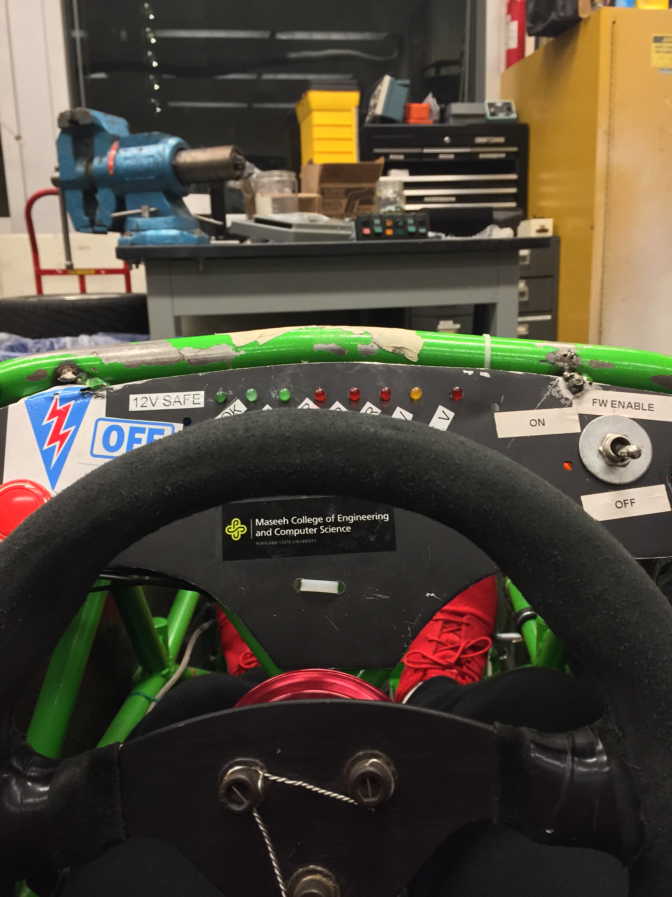
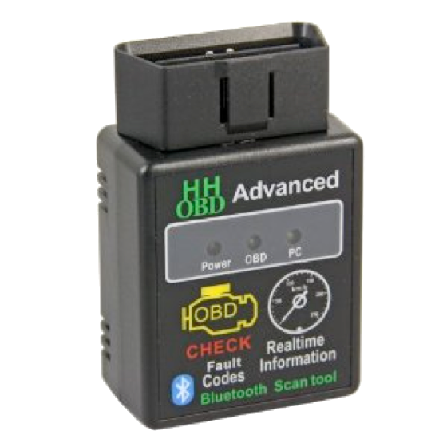
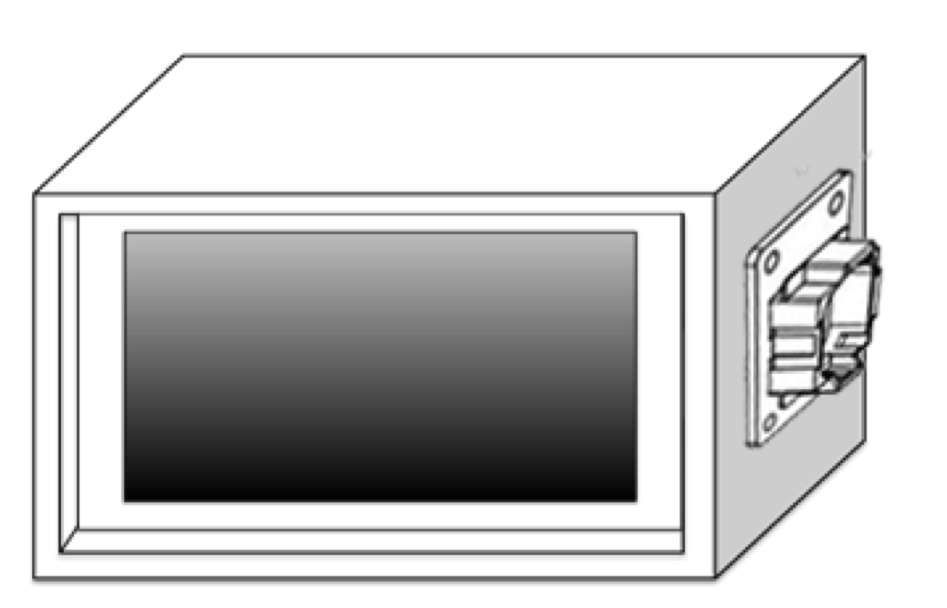
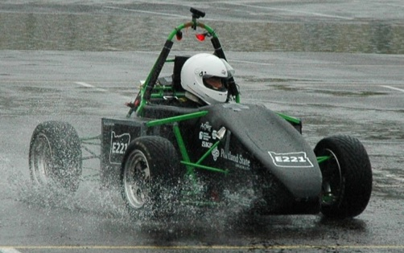
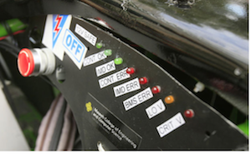
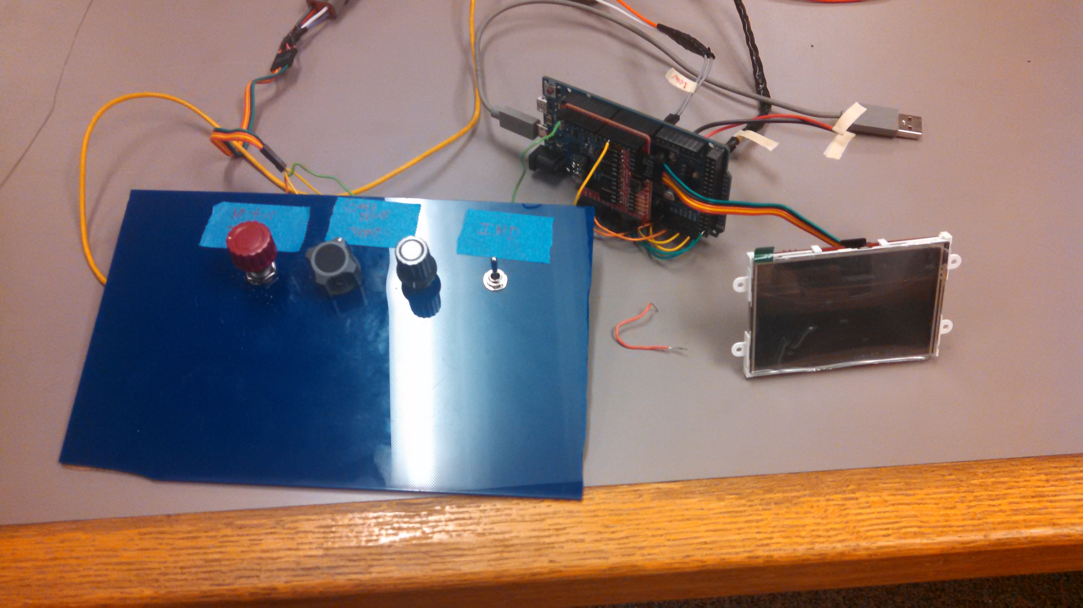
Digital Dashboard for SAE Electric Race Car
Capstone Team: Noah Erickson, Chad Thueson, Rishal Dass, Jaime Rodriguez, Sean Koppenhafer
Project Sponsor: Michal Podhradsky – Viking Motorsports Team
Capstone Advisor: Dr. Christof Teuscher – Portland State University ECE Department
Prior Work
Implementation
placeholder
In the realm of racing, each car is designed completely different based on several factors not limited to driver preferences, resources available and technical limitations. A few popular choices for digital dashboards currently exist. The popular Haltech Racepak is not only expensive, but requires the use of Haltech’s standalone ECU to source the data for the dash. Another popular solution is a bluetooth adapter that plugs into the OBDII port of the race car. This requires the car to be designed with OBDII capabilities.
CAN Transceivers
Microprocessor
Screen
Maybe move open source explanation from solution to this section?
Hardware
LCD Mating
Header
Motivation
Dashboard space on the car was at a premium. The limited space dictated two large design choices:
The 3.5” Display Size
The custom PCB to minimize area
CAN Inputs
The increased complexity that high voltage systems introduce into a racecar require increased diagnostics to keep the car running safely and correctly. The Viking Motorsports team had previously used a bank of LEDs to indicate problems with mission critical systems. Troubleshooting these problems required the car to be off the track and for logged data to be analyzed. With the addition of a digital dash system that reads data in real time from the vehicle control unit, the driver can be kept up to date on system functionality both on track or in the pits.
Further Improvements
The digital dash could be modified to operate in any race car.
Screen size could be modified to fit the individual cars dashboard.
The mainboard could be reprinted with modifications made after the first board revision.
An improved power supply could be implemented to further reduce power consumption.
The enclosure could incorporate a cowl in order to improve readability in direct sunlight.
The entire system was first prototyped using an Arduino Due which was slightly too large for the solution we had in mind.
The screen was smaller than the Arduino Due and there would have been a lot of wires plugging into the screen. We wanted our device to be as plug-and-play as possible so we created a custom PCB that would plug directly into the LCD with no “mod wires”.
Programming Circuit
12V Supply
Software
Conclusions
Solution
The software for the Digital Dashboard was created using the Arduino IDE. In order to interface with the vehicles CAN bus and the 4D systems screen, two libraries provided by the distributer were used. The software receives data from the vehicles CAN bus looking for pertinent messages, interprets the messages, and sends the interpreted data to the screen.
The digital dash performs as designed under the operation of the demo unit that was created. The potentiometers send analog inputs to the eVCU to simulate values that the car would get from different components on the vehicle. The eVCU then translates these values into CAN messages and sends them to the digital dash.
Three major requirements were addressed when designing the digital dash. The microprocessor needed to support the CAN protocol along with the TTL serial protocol. The 32bit 84MHz ATSAM3X microprocessor, which is used on the Arduino Due, fit the bill. This allowed the design team to rapidly prototype the system on the Arduino Due. The final component was the screen. The screen needed a high resolution to draw gauges and display information while also having a compact size. A 3.5” LCD from 4D Systems was ultimately chosen.
The Viking Motorsport team wanted us to design the digital dashboard to be open source and well documented. To achieve this goal we chose to host our project on Github and post documentation to aide other racing teams in the process of creating a digital dash.
Screen
4D Systems supply an IDE to aide in quickly developing interfaces for their screens. The user interface was designed to be simple and intuitive. It also utilizes the touch capability of the screen in order to navigate through multiple screens to view data from different systems. The screen receives data from the mainboard through the TTL serial protocol.
Due to circumstances outside our control the digital dash has not been tested on the electric vehicle itself.
Acknowledgements
Special thanks to Quinn Sullivan for helping with integration onto the vehicle
Notes:
1

